Slide 1
Chapter 8/9 – Assumptions, Security, and Attacks

Slide 2
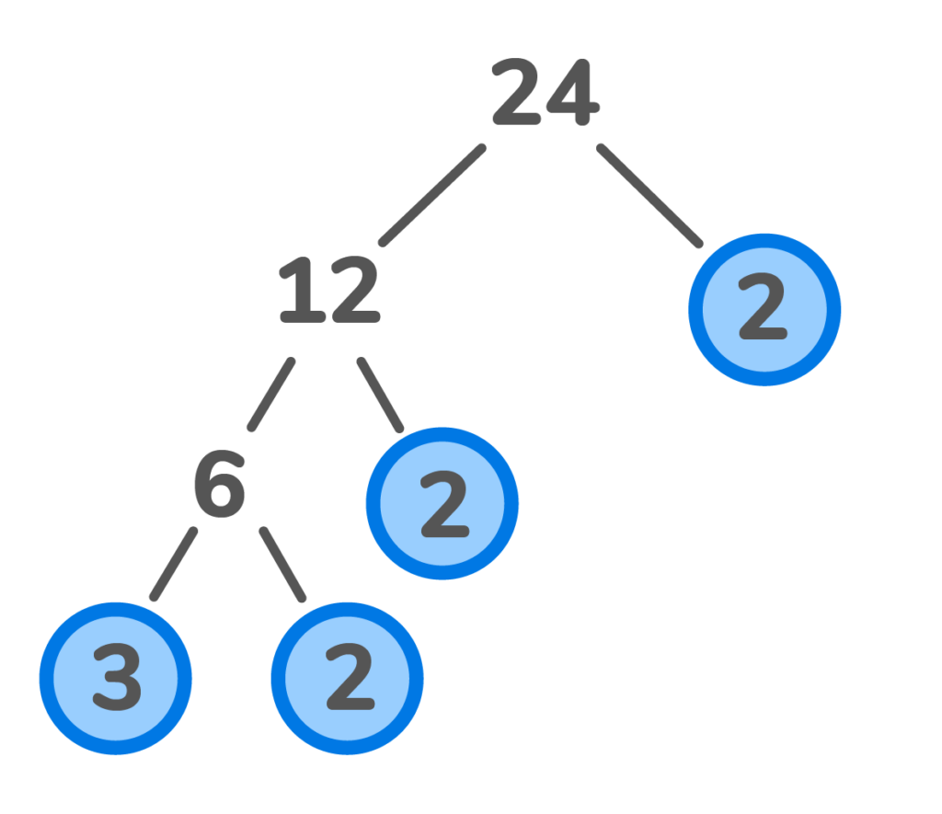
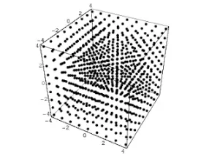
Assumptions
Where It’s Used
Random lattices are importantly used in key generation, signatures, and some transformations
SQI_{SIGN} requires several important numbers be large prime numbers, importantly the modulus p when constructing the field F_{p}
SQI_{SIGN} uses quadratic residues to ensure that points lie on a curve. There is an extra layer of security as attackers shouldn’t be able to distinguish between residues and non-residues
SQI_{SIGN} uses ideals to compute isogenies, the basis of the digital signature
Random Lattices
Random Lattices
Quadratic Residue - a number that can be expressed as the square of an integer within a given modular system
SQI_{SIGN}
Primality
Primality
Ideal Size
Ideal Size
Why It’s Needed
Quadratic Residuosity
Conditions
Quadratic Residuosity
Conditions
There is an extra layer of security as attackers shouldn’t be able to distinguish between residues and non-residues
If the ideals are too small, the security of the scheme is compromised. If they are too large, the computation will be too resource-intensive
Ensures the elliptic curve structure is preserved and simplifies the process of working with them. Also improves security as factorization can’t be used to break down the curves
The randomness of the lattices in SQI_{SIGN} ensures they can’t be reconstructed

Slide 3

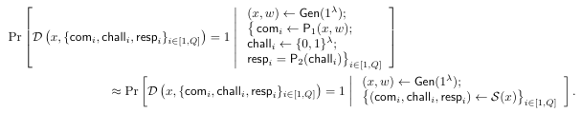
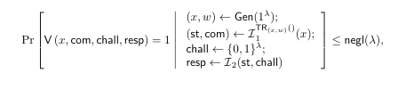
Security Reductions
Digital Signature Security with Fiat-Shamir
EUF-CMA: Existential unforgeability against chosen message attacks
Theorem: If a ∑-protocol satisfies IMP-PA, then that protocol after a Fiat-Shamir transformation also satisfies EUF-CMA
IMP-PA Security
(Impersonation Under Passive Attack)
Theorem: Any ∑-protocol that satisfies special soundness and wHVZK also satisfies IMP-PA
IMP-PA says that even if someone is strictly observing the protocol without interacting, they are still unable to obtain information about the secret key
Special Soundness
The property that prevents cheating. If someone can produce two distinct correct responses, they must know the secret key. (ie. They must know the x as well as the w.
In SQI_{SIGN} soundness relies on the difficulty of computing the endomorphism ring
Weak Honest-Verifier Zero-Knowledge
The verifier doesn’t gain any information about the private key during the verification process. A scheme could produce other results that are indistinguishable from real results
This is not explicitly handled in SQI_{SIGN} in terms of producing “fake” results, but the scheme handles with the multiple isogenies.
Correctness
V(x, comm, chall, resp) = 1
Variables:
x: public key
w: private key
com ←P1(x,w): commitment
chall ←{0,1}^{λ} : random challenge from verifier
resp ← P2(chall): response to challenge from prover
These are properties that the ∑-protocol should satisfy:
Correctness
Special Soundness
Weak Honest-Verifier Zero-Knowledge
IMP-PA Security
Digital Signature Security with Fiat-Shamir
✓
✓
✓
✓
✓

Slide 4
Security of SQI_{SIGN}
→
→
Soundness
wHVZK
EUF-CMA
✓
✓
✓
Supersingular Smooth Endomorphism Problem: Given a prime p and an elliptic curve E over F_{p^2,} find a (non-trivial) endomorphism of E of smooth degree.
Theorem: If the endomorphism ring is computed, then there must exist an algorithm capable of doing so.
Can an attacker strictly observing the protocol distinguish real from ‘fake’ isogenies?
Proven by three further assumptions: success probability of signing algorithm, statistical closeness of isogeny distributions, and computational indistinguishability of distributions
Theorem: If a ∑-protocol satisfies IMP-PA, then that protocol after a Fiat-Shamir transformation also satisfies EUF-CMA

Slide 5
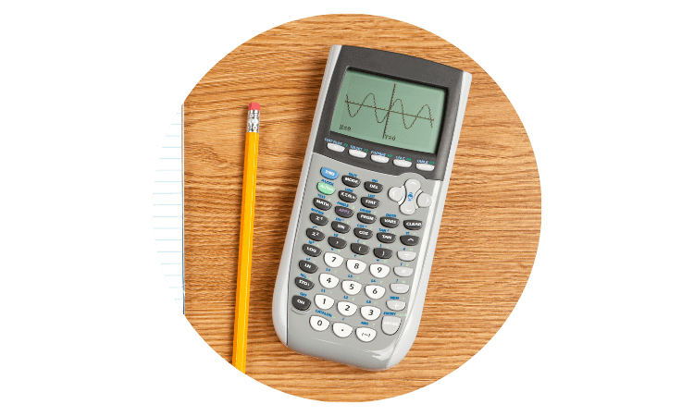




Resistance Against Known Attacks
Endomorphism Ring Computation
Key Recovery
Soundness/Forgery
Algorithm Failure
Zero-Knowledge

Slide 6
Thank you!

